Slide 1
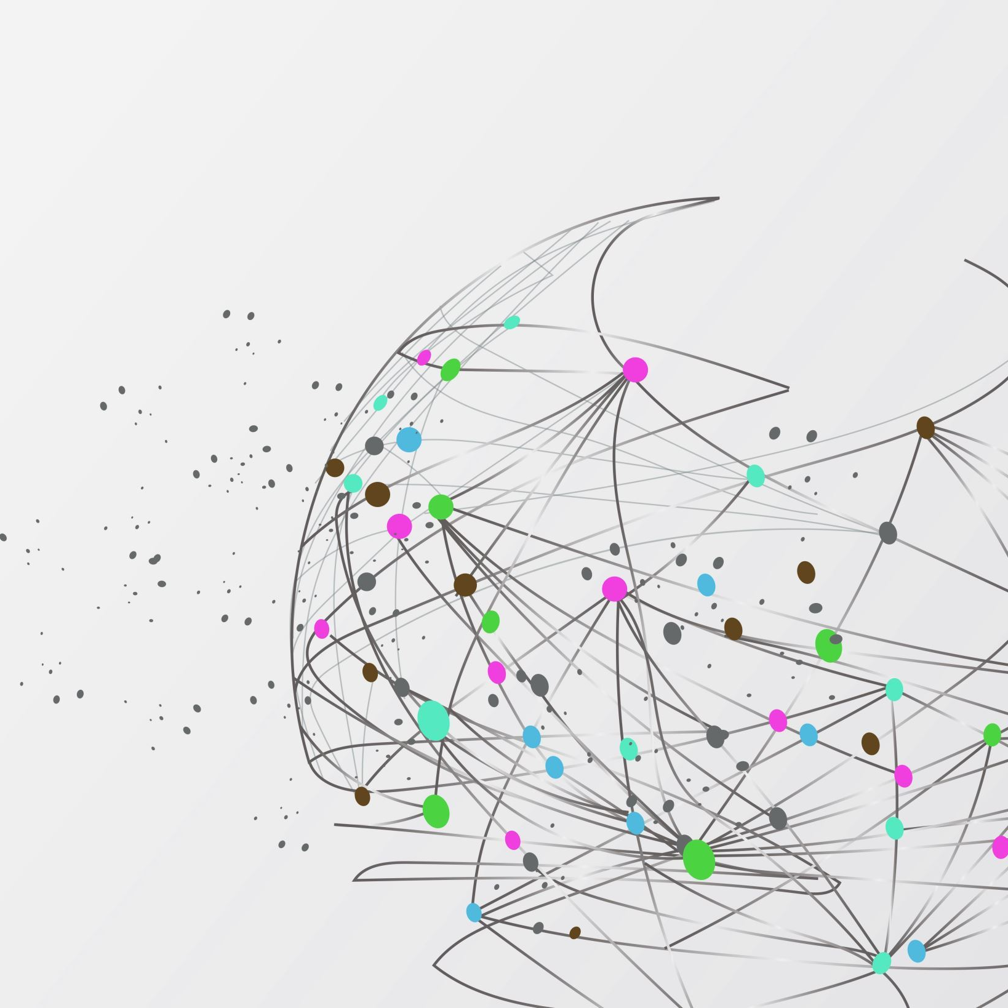
MUSIC2MOVIE -
CROSS DOMAIN RECOMMENDATION SYSTEM
GROUP 2: MARINA MITIAEVA, ARUNAVA DAS, RAGHUVEERA NARSIMHA

Slide 2

OBJECTIVE
Develop a recommendation system connecting songs and movies.
Leverage deep learning models for cross-media recommendations.
Goal: Suggest movies that align with users' music preferences.
Stakeholders: Users (improved discovery), Platform owners (enhanced engagement), Advertisers (increased interaction)

Slide 3

DATASETS USED
Spotify Dataset (Hugging Face):
113,999 Tracks
20 Features (e.g., Danceability, Energy, Valence, Tempo)
TMDb Movies Dataset (Kaggle):
1,110,815 Movies
24 Features (e.g., Genres, Popularity, Revenue, Runtime)

Slide 4
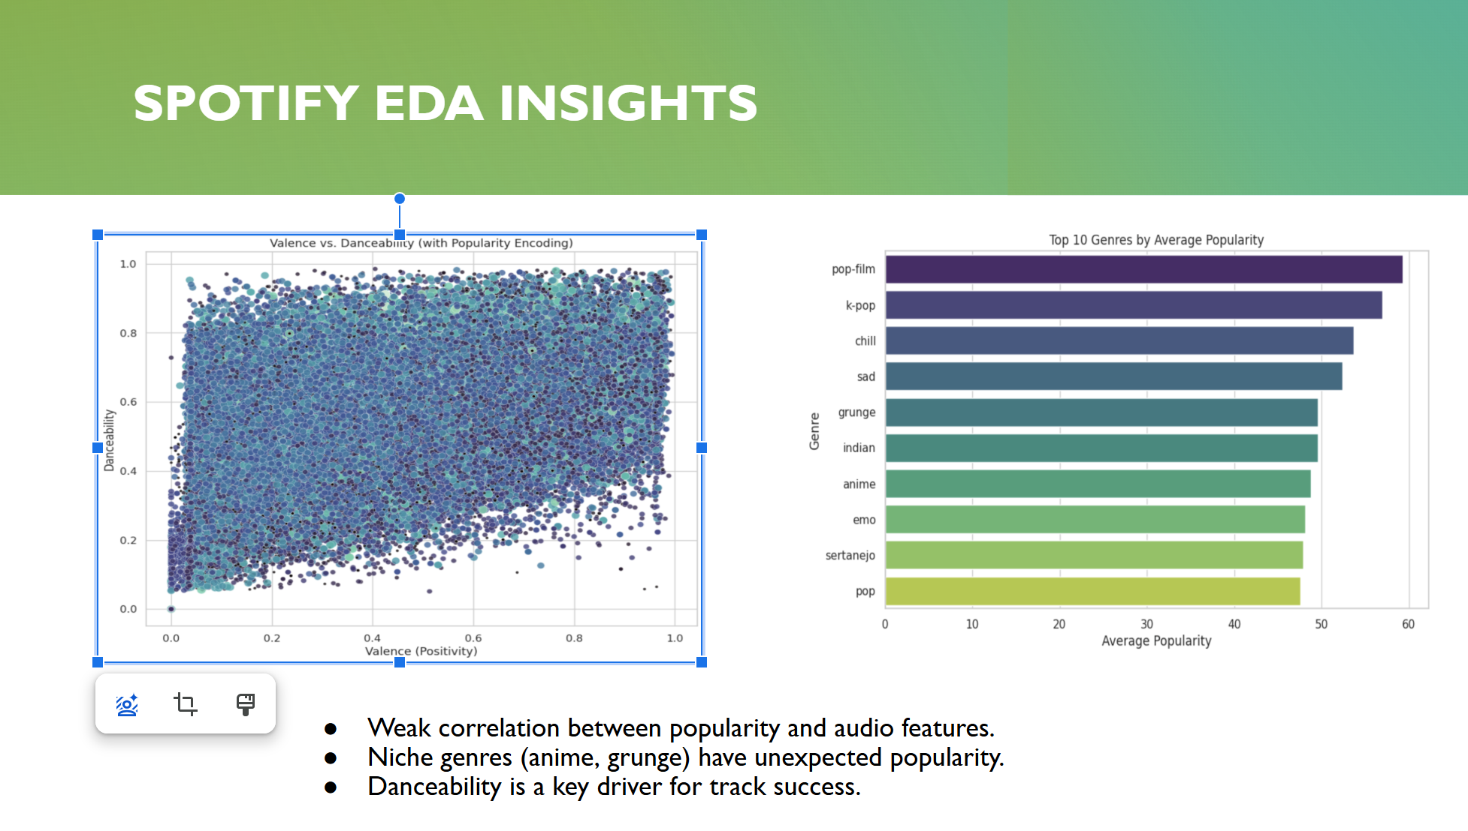
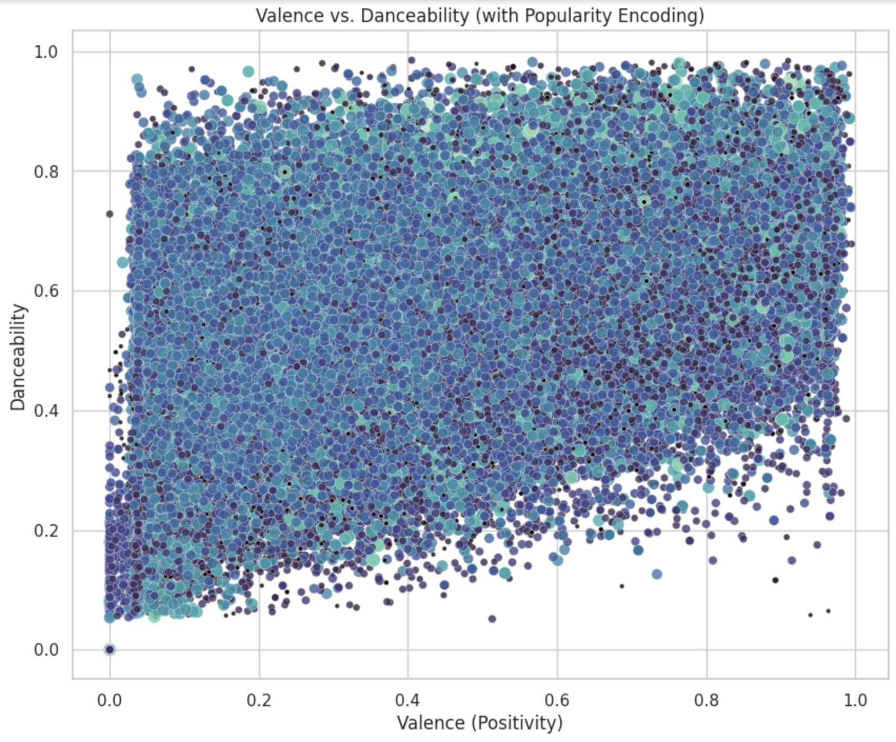
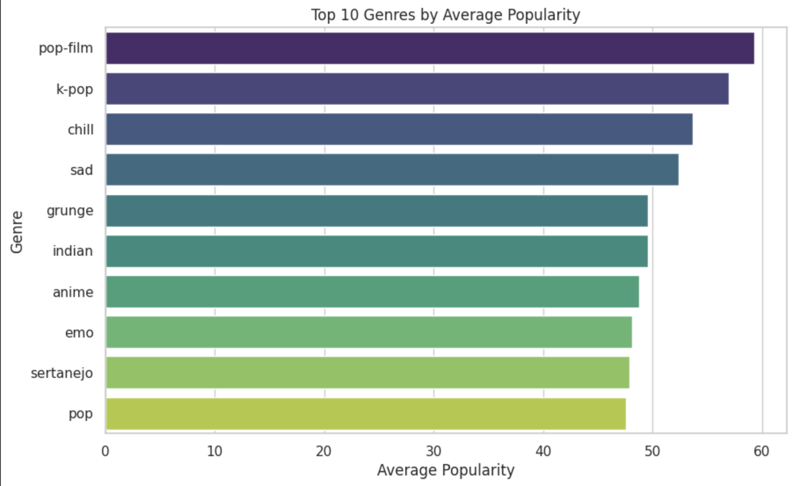
SPOTIFY EDA INSIGHTS
Weak correlation between popularity and audio features.
Niche genres (anime, grunge) have unexpected popularity.
Danceability is a key driver for track success.

Slide 5
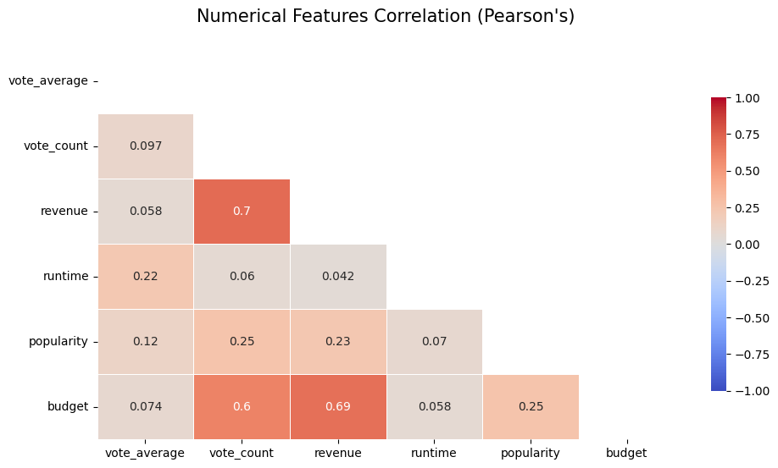
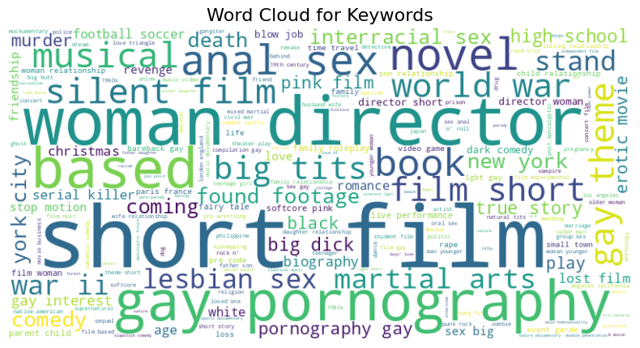
TMDb EDA INSIGHTS
Requires extensive preprocessing (removal of nulls, deduplication).
Strong correlation between revenue and budget (0.69).
Contains explicit content requiring filtering for accurate analysis.

Slide 6
CLEANING & MODEL INPUT
Cleaning steps:
Duplicate Removal: Ensured data consistency by removing redundant rows.
Missing Values Handling: Removed rows with missing values in essential columns (e.g., title, genres, overview).
Explicit Content Exclusion: Excluded movies flagged as adult content (adult = True)
Feature Selection: Retained features like vote_average, runtime, popularity, sentiment, and poster embeddings.
Spotify Dataset:
Audio Features: danceability, energy, valence, tempo, loudness, popularity.
Metadata: track name, artist name, genre.
TMDb Movies Dataset:
Textual Features: overview sentiment.
Numerical Features: vote_average, vote_count, runtime, popularity.
Visual Features: poster embeddings (extracted via MobileNetV2).

Slide 7
END-TO-END PIPELINE
Complete Recommendation Pipeline
1. Data Collection and Preprocessing
Spotify: Extract audio features and normalize attributes.
TMDb: Clean data, extract poster embeddings, perform sentiment analysis.
2. Feature Engineering
Normalize and align features from both datasets.
Generate embeddings for songs and movies.
3. Embedding Construction
Combine movie and song features into a shared embedding space.
Training record: concatenated embeddings of song and movie attributes.
4. Similarity Calculation
Compute cosine similarity between song and movie embeddings.
5. Recommendations
Rank movies by similarity scores.
Output top 5 movies with metadata and scores.

Slide 8
MODEL OUTPUT
Recommendation System Results
Prediction:
Generates similarity scores ranging between 0 to 1 between input songs and movies for each row of data.
Recommendation:
Top 5 Movies: Based on highest similarity scores.
Metadata Included: Movie title, genres, popularity, similarity score.

Slide 9
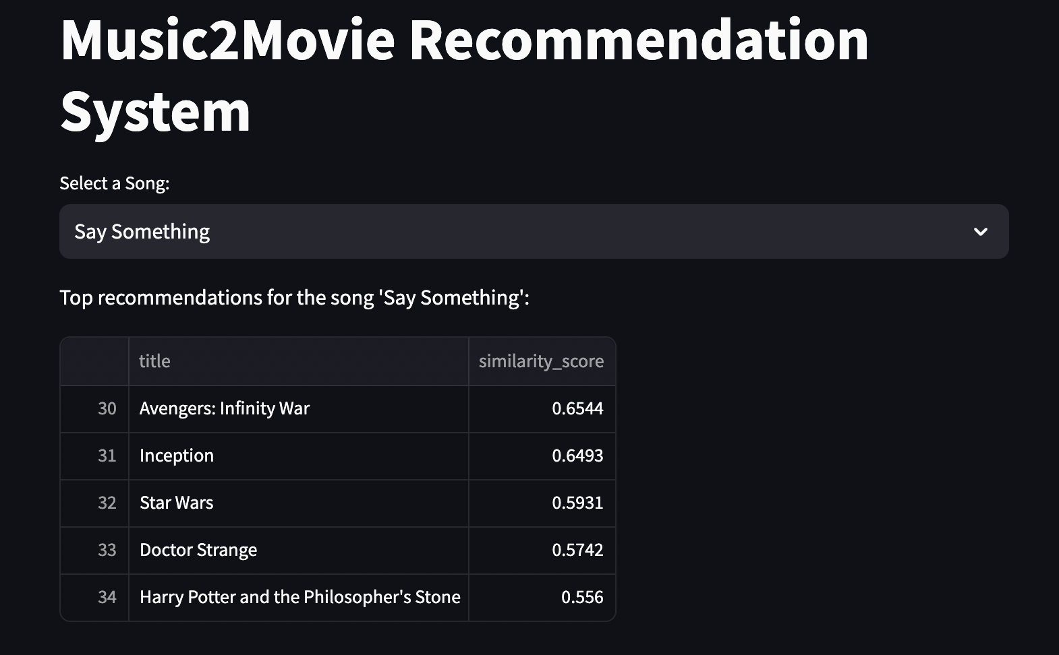
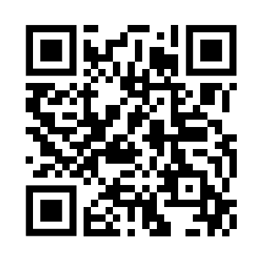
VISUALIZING THE OUTPUT WITH STREAMLIT APP
https://music2movierecommender.streamlit.app/
https://music2movierecommender.streamlit.app/

Slide 10
FUTURE WORKS
1
2
3
Integrate user feedback for iterative improvements
Explore advanced models (e.g., Transformer-based embeddings)
Enhance the Streamlit App

Slide 11



CONCLUSION
Impact: Innovative cross-domain recommendations enhancing user engagement.
Value Creation: Benefit to users, platforms, and advertisers.
Future Potential: Scalability across other entertainment platforms.

Slide 12

THANK YOU
QUESTIONS?

